Slide 1

Recurrent Neural Networks
Why sequence models?
deeplearning.ai

Slide 2
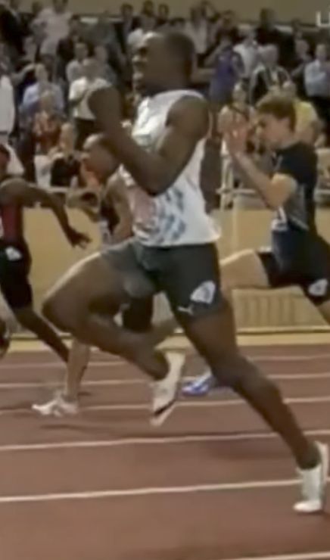
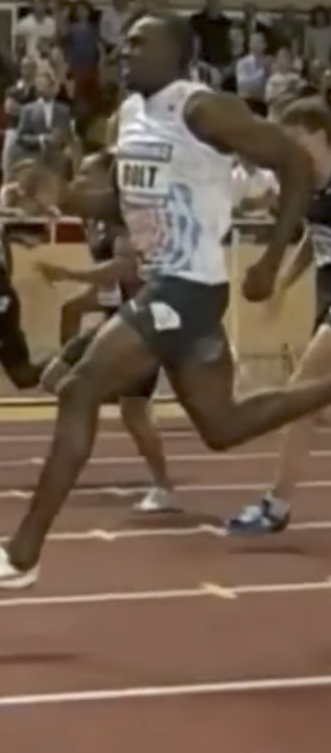
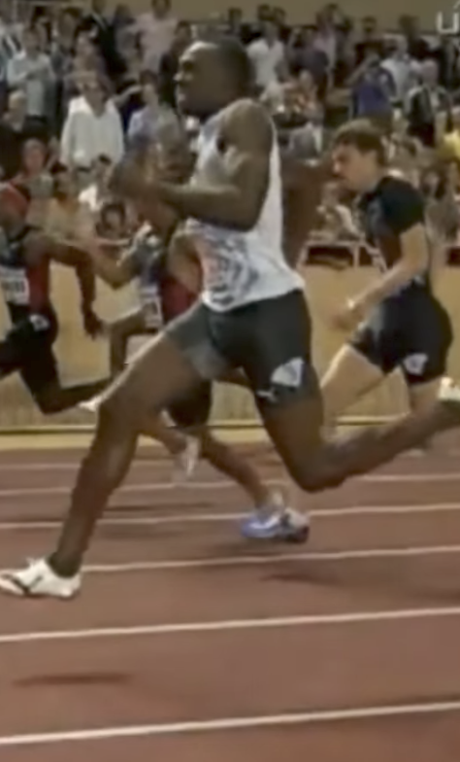
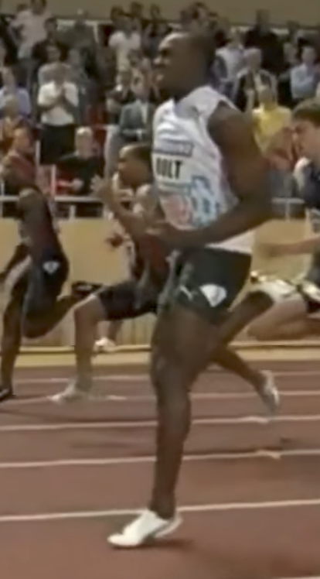
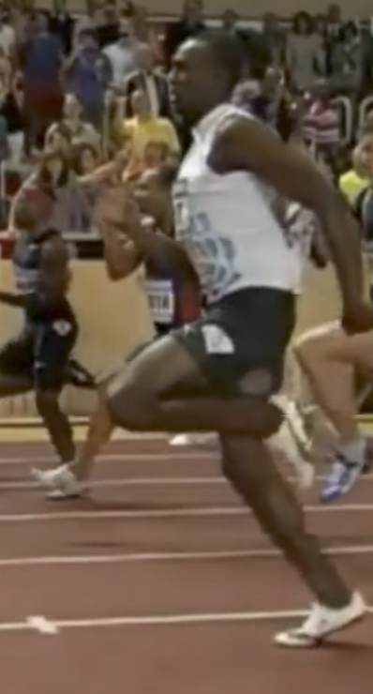

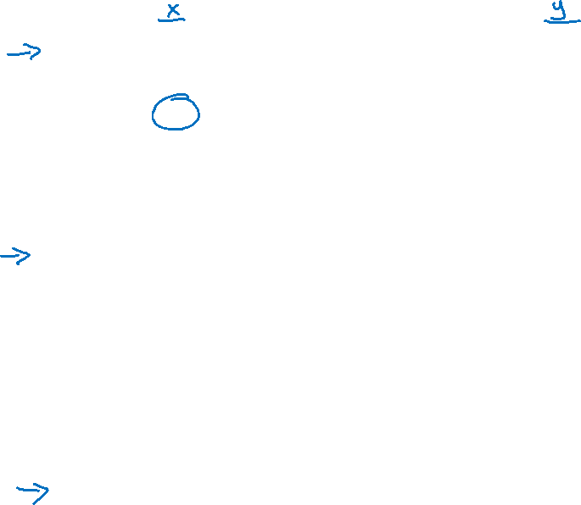
Examples of sequence data
“The quick brown fox jumped over the lazy dog.”
Speech recognition
Music generation
$$∅$$
Sentiment classification
“There is nothing to like in this movie.”
DNA sequence analysis
AGCCCCTGTGAGGAACTAG
AGCCCCTGTGAGGAACTAG
Machine translation
Voulez-vous chanter avec moi?
Do you want to sing with me?
Plasmid sequence AP4 Oligo
Video activity recognition
Running
Name entity recognition
Yesterday, Harry Potter met Hermione Granger.
Yesterday, Harry Potter met Hermione Granger.

